Slide 1
Two weeks in Michigan

Slide 2
They said we’d learn R, awk, and the shell

Slide 3
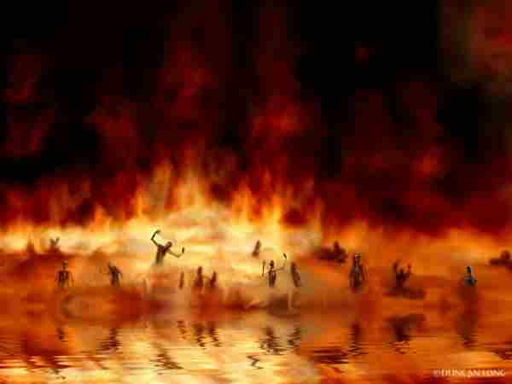
They said we’d learn R, awk, and the shell
Programming, assembly- two weeks in hell

Slide 4
First we met Titus, King of the Booze

Slide 5
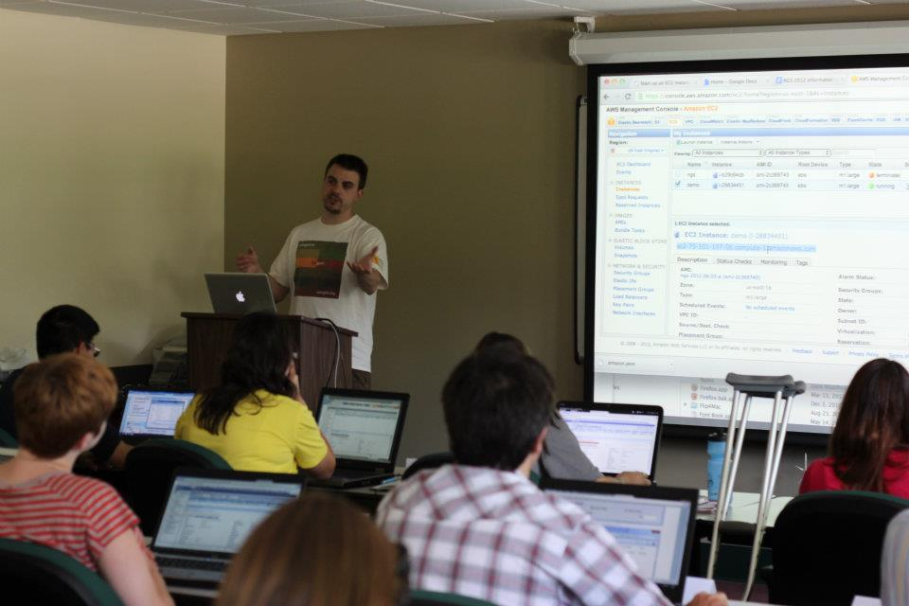
First we met Titus, King of the Booze
Whenever he teaches he never wears shoes

Slide 6
Istvan and Eric and don’t forget Ian

Slide 7
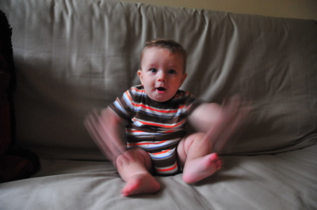
Istvan and Erich and don’t forget Ian
Fast talkers, fast typers, we can’t even see’em

Slide 8
Corbin and Julien and all the TAs

Slide 9
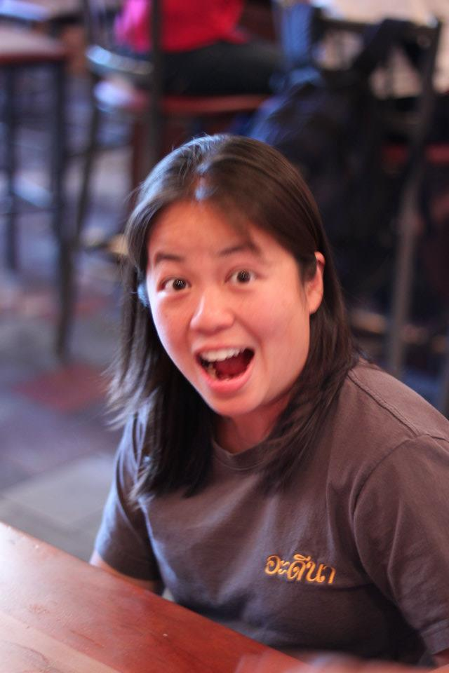
Corbin and Julien and all the TAs
With all of our questions they never seemed fazed

Slide 10
We lessed and we mored, used tail and head

Slide 11
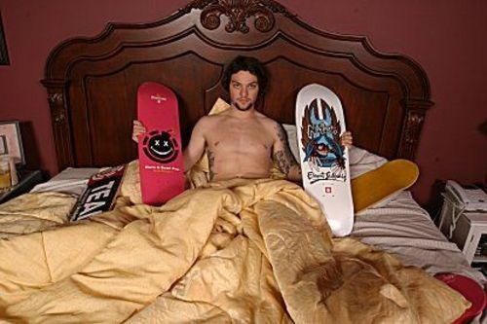
We lessed and we mored, used tail and head
We BamtoSamed and we BammedtoBed

Slide 12
We learned ‘bout git, bash, and curl

Slide 13
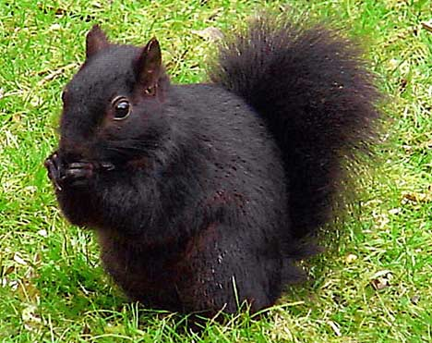
We learned ‘bout git, bash, and curl
And red, and grey, and black MySquirrels

Slide 14
Outside we bumped, and set, and spiked

Slide 15
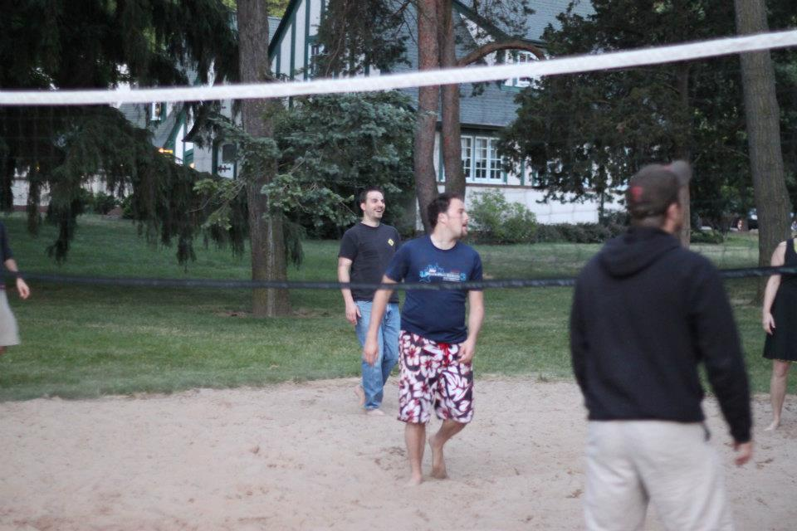
Outside we bumped, and set, and spiked
With dudes like Neal and Mike and Mike

Slide 16
The courts were brutal, situations were dire

Slide 17
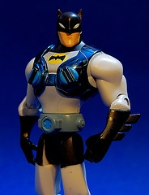
The courts were brutal, situations were dire
We discovered the dangers of boobs and underwires

Slide 18
Injuries abounded, crutches left and crutches right

Slide 19
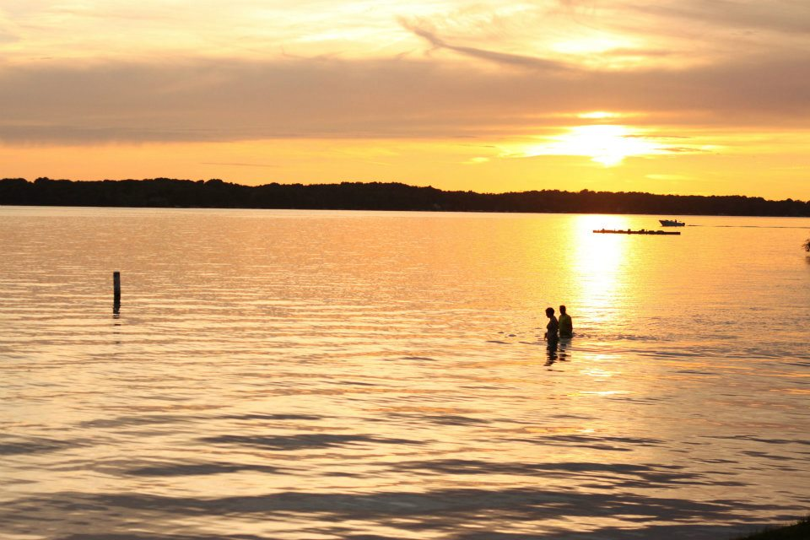
Injuries abounded, crutches left and crutches right
But don’t worry, Titus, we never swam alone at night

Slide 20
Gin flowed like wine and wine like beer

Slide 21
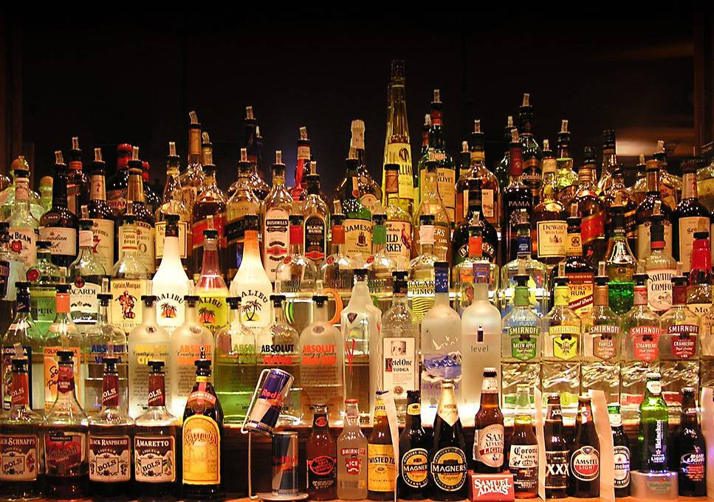
Gin flowed like wine and wine like beer
Tequila and whiskey… I can’t list it all here

Slide 22
Thank you to Titus and all of the rest

Slide 23
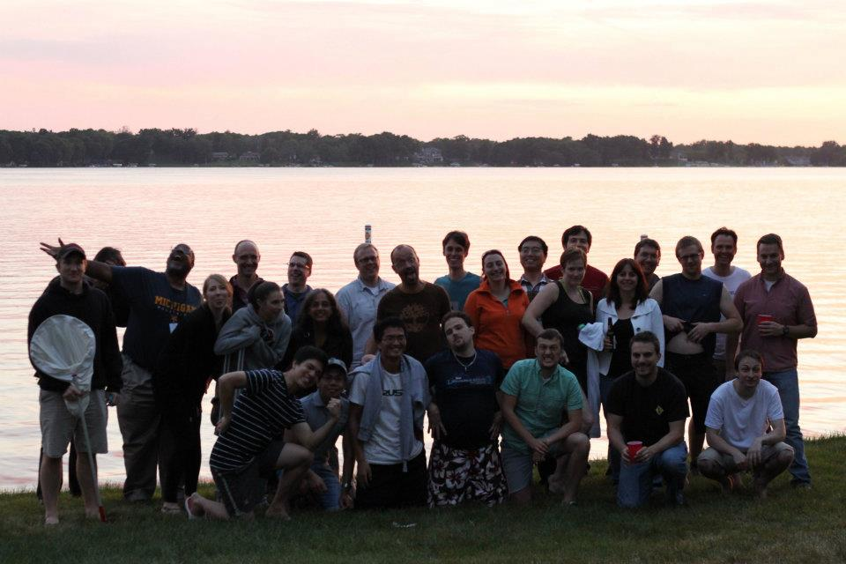
Thank you to Titus and all of the rest
The course was a success and you’re the best of the best!

